Slide 1

Mini Project FINAL Presentation SESSION 2022-23
Department of Information Technology
ABES Engineering College, Ghaziabad, UP
ChainVote
(Blockchain Based Voting System)
Name-Sudhanshu Shekhar Pandey
Class & Section-IT C
Roll No. – 2100320130172
Admission No. - 2021b0131086

Slide 2
TABLE OFCONTENTS:
INTRODUCTION TO VOTING SYSTEMS
ABOUT THE PROJECT DOMAIN: BLOCKCHAIN
PROJECT BASED LEARNING UNDER THE DOMAIN COURSE
WORKING OF VOTING SYSTEM
METHODOLOGY
TECHNOLOGIES UDED
OUTPUT SNIPPETS
CHALLENGES AND LIMITATIONS OF PROJECT
CONCLUSION

Slide 3
Introduction to Voting Systems
Voting is a cornerstone of democracy, allowing citizens to choose their representatives and influence the direction of their society. However, traditional voting systems face several challenges that can undermine public trust and the integrity of elections.
Imagine a world where elections are:
Secure: No more worries about vote tampering or fraud.
Transparent: Every step of the voting process is publicly verifiable.
Accessible: Anyone with a device and internet connection can vote from anywhere.
Efficient: Vote counting can be automated and completed quickly.
This is the promise of blockchain-based voting systems. In this presentation, we'll explore how blockchain technology can revolutionize the way we vote.

Slide 4
Challenges of Traditional Voting Systems
Vulnerability to fraud: Paper ballots can be forged, tampered with, or miscounted. Voting machines can be hacked .
Lack of auditability: It can be difficult to verify the accuracy of vote counts, particularly with paper ballots.
Human error: Counting large numbers of ballots by hand is prone to human error, leading to miscalculations.
Lack of real-time results: Voters often have to wait days or even weeks for official election results.
Limited public oversight: The vote counting process can be opaque, making it difficult for the public to verify its accuracy.
Disenfranchisement: Long lines and limited polling station accessibility can discourage people from voting.
Physical limitations: People with disabilities or those who are unable to travel to polling stations may face difficulties voting.
Geographical restrictions: Voters who live overseas or in remote areas may be unable to cast their ballots.
Time constraints: Busy schedules or work commitments can prevent people from voting during limited polling hours.

Slide 5
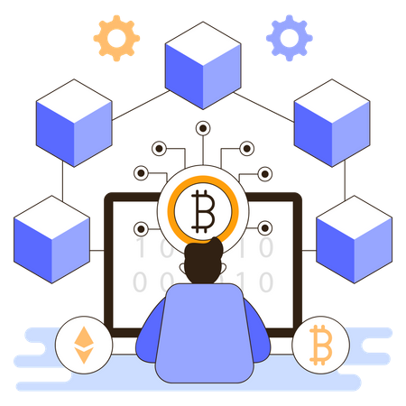
ABOUT THE Project Domain: blockchain
A blockchain is a type of distributed ledger technology (DLT) that consists of growing lists of records, called blocks, that are securely linked together using cryptography.
Blockchain is a shared, immutable ledger that facilitates the process of recording transactions and tracking assets in a business network. Blockchain is a promising technology for payment processing. Blockchain has been able to give underbanked groups access to money, allows people to make cross-border payments and uses smart contracts to act as a means towards faster and safer payment processing.

Slide 6
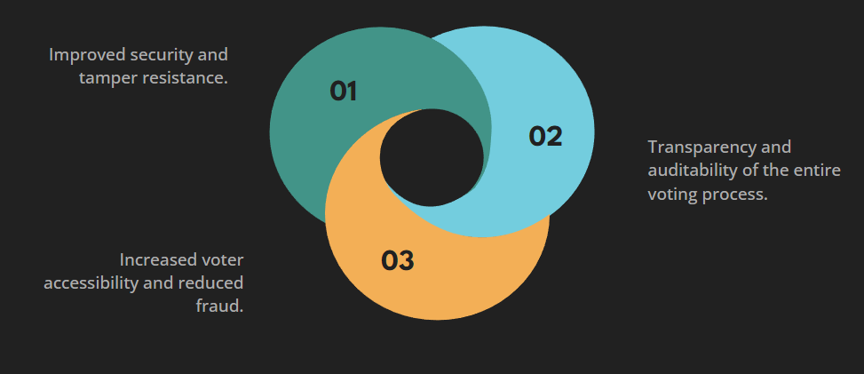
Project BASED LEARNING UNDER THE domain COURSE

Slide 7
Key features of Blockchain :
High Availability
Verifiability
Transparency
Immutability
Distributed Ledgers
Decentralised
Enhanced Security
Scope
The scope of the system is very vast as it can be implemented in any organization where elections play a major role in electing their representatives.The system can be adapted as per the need and the number of participants using the system.The techniques and concepts used in providing a base to the system uses strong encryption techniques to provide privacy to the votes and tamper free results.

Slide 8
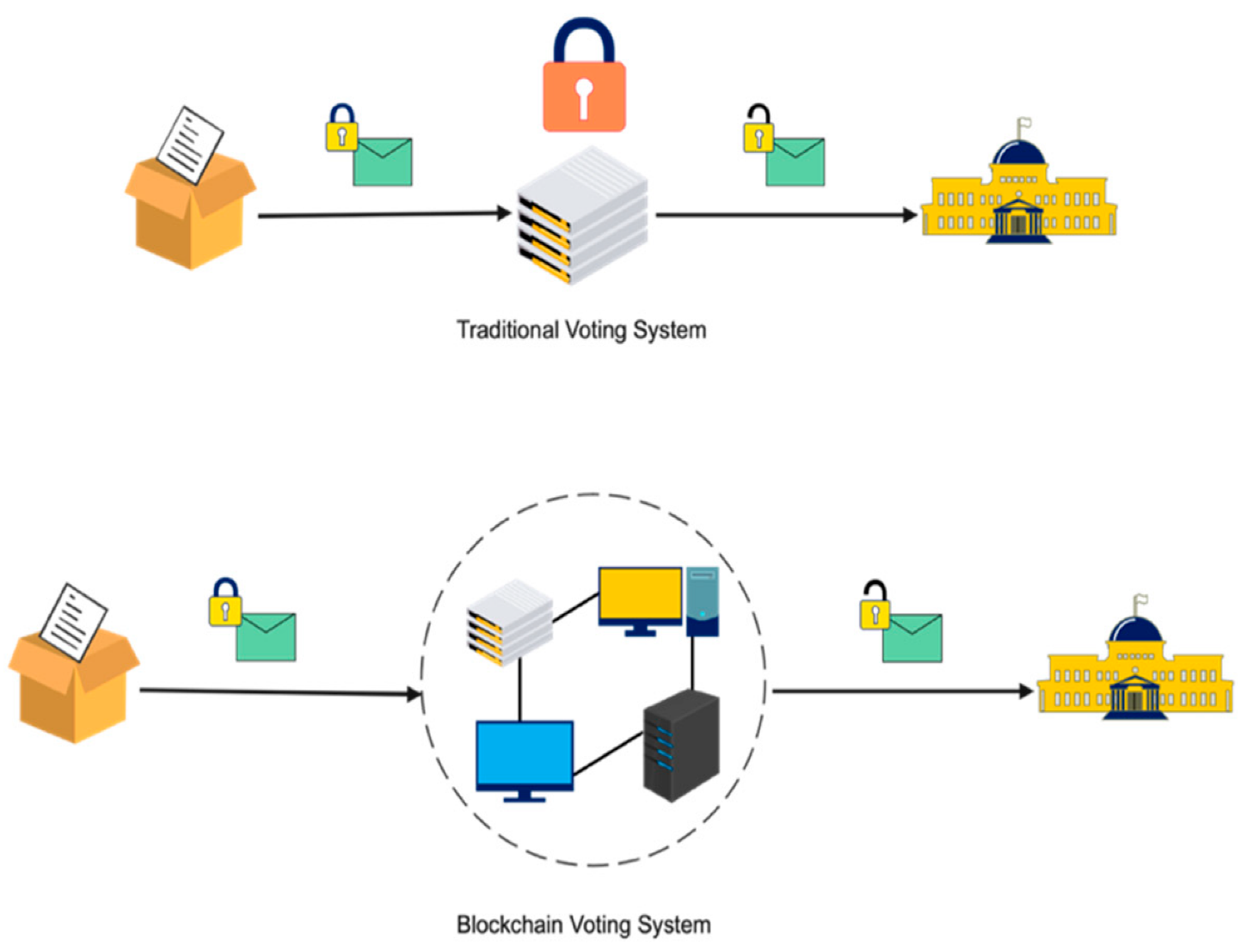
WORKING OF VOTING SYSTEM
How does Blockchain work for Voting?
Voter Registration: Voters register on the blockchain using a secure verification process. Their identity is encrypted and stored without revealing personal information.
Ballot Creation: Election officials create digital ballots and upload them to the blockchain. The ballots are encrypted to ensure secrecy.
Voting: Voters cast their votes on their devices using a secure voting app. Their votes are encrypted and recorded on the blockchain.
Vote Counting: After the election, votes are automatically counted by the blockchain system. The results are publicly verifiable and tamper-proof.

Slide 9
Imagine an election where your vote counts, remains tamper-proof, and you can cast it from anywhere in the world. This is the promise of blockchain-based voting systems, transforming traditional methods with enhanced security, transparency, and accessibility. Let's explore the process step-by-step:
1. Voter Registration and Authentication:
Identity Verification: Voters register on the blockchain using an identity verification process, such as biometrics or secure government IDs. This information is encrypted and stored without revealing personal details.
Digital Voting Key: Each registered voter receives a unique digital key paired with a public address on the blockchain. This key acts as their "voting passport" and ensures only eligible individuals can cast ballots.

Slide 10
2. Ballot Creation and Encryption:
Election Officials: Authorized officials create digital ballots with candidates and proposals. These ballots are encrypted to ensure secrecy and immutability, meaning they cannot be altered once stored on the blockchain.
3. Casting and Counting Votes:
Secure Voting App: Voters download a secure voting app on their devices. Using their digital key, they access their personalized ballot and cast their vote anonymously. The vote itself is encrypted again for further security.
Adding to the Chain: The encrypted vote is broadcasted to the blockchain network. Nodes (validators) verify the voter's eligibility and add the vote to the next block in the chain.
Automatic Counting: When the voting period ends, a smart contract on the blockchain automatically decrypts and tallies the votes. The results are publicly visible on the chain, ensuring transparency and reducing concerns about human error.

Slide 11
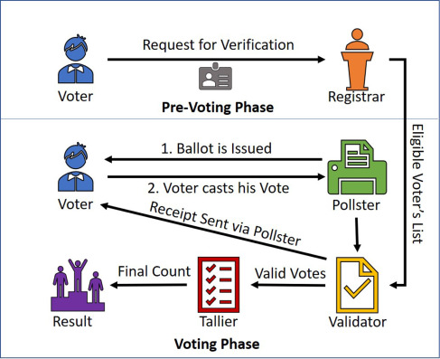

Slide 12
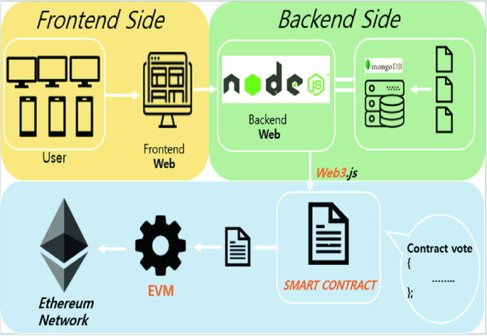
METHODOLOGY
Proposed Plan of Work: For our proposed plan of work we are considering two modules that are to be completed in three phases. Two modules are as follows:
Front-end for the application
Back-end using Solidity to implement Blockchain.
Each of these module will be considered as one phase and the remaining one phase will cover the connection and testing of these modules.

Slide 13
We have considered 2 main modules which are as follows:
Admin- The admin module is divided into 5 components-
Dashboard-It will contain various charts to display information such as number of parties, number of voters etc.
Add Candidate - In this feature of admin, he can add candidates who are standing in the election. After candidate is added it will be displayed on the user side.
Create Election- This feature of admin will allow him to create election. A user can cast his vote only after the election is created by admin. A user can cast vote between the start date and end date.
Candidate Details- In candidate details all the candidates added by admin will be displayed. Admin can update the candidate details if incase a wrong entry is done.
User- The user module is divided into 4 components
Dashboard- The user dashboard contains information about parties and their candidates. A user can see all the information about candidate.
Voter Register- In this section first user will have to register himself only then he will be able to cast his vote.
Voting Area- After user is registered, then only he will be directed to this page and then he can cast his vote.
Results- In this component the user will be able to see the results of the election.

Slide 14
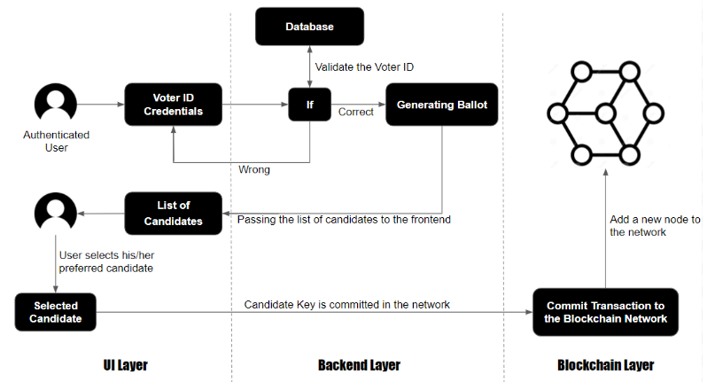

Slide 15
Technologies used
Decentralized Election voting System project using Blockchain technology such as Metamask, hardhat, and Remix IDE.
Technologies Used :
1. Metamask
2. hardhat
3. Visual Studio Code
Languages used
1. React.js
2. ether.js
3. solidity

Slide 16
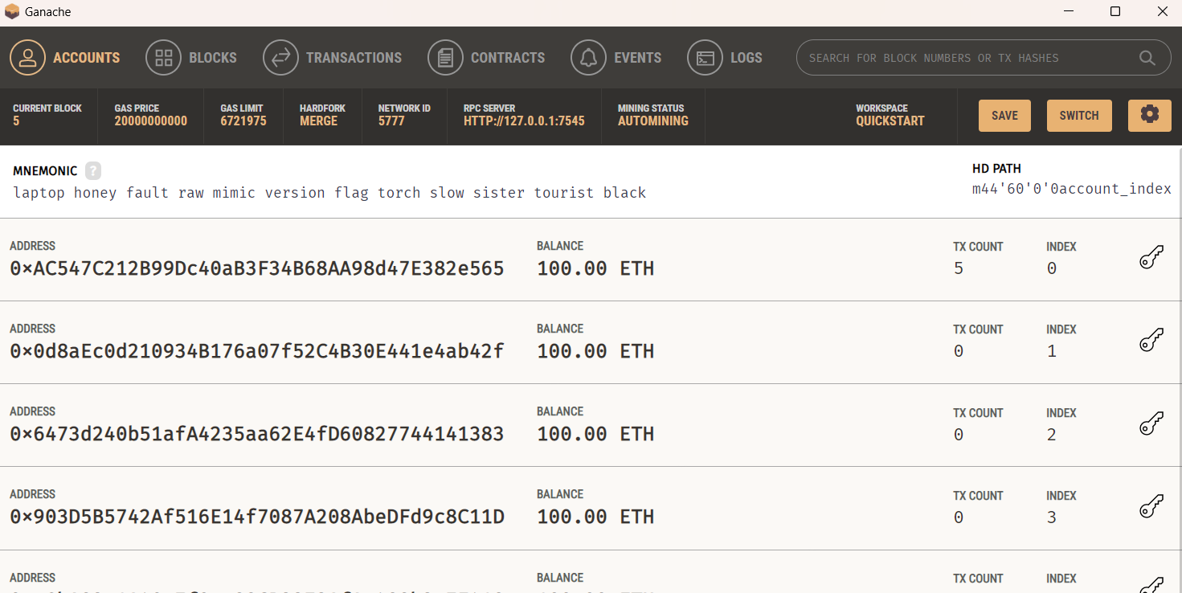
Tools used: Ganache
Ganache is a private ethereum blockchain environment that allows to you emulate ethereum blockchain so that you can interact with smart contract in your own private blockchain.
Ganache is a personal blockchain for rapid ethereum and corda distributed application development.

Slide 17
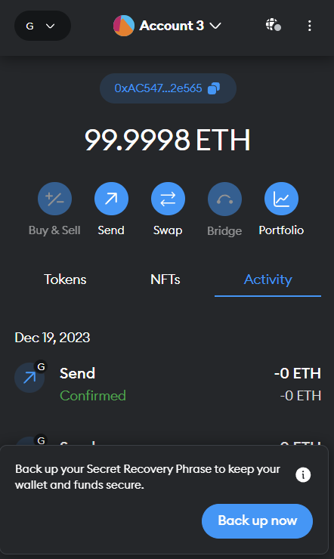
Tools used: MetaMask
MetaMask is a cryptocurrency wallet that enables users to store Ether and other ERC-20 tokens.
The wallet can also be used to interact with decentralized applications or dapps.

Slide 18
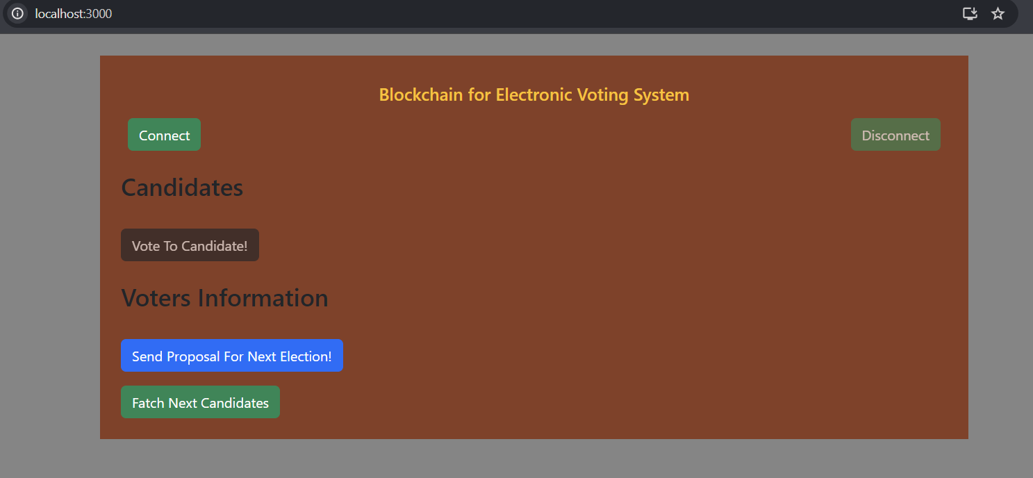
OUTPut snippets

Slide 19
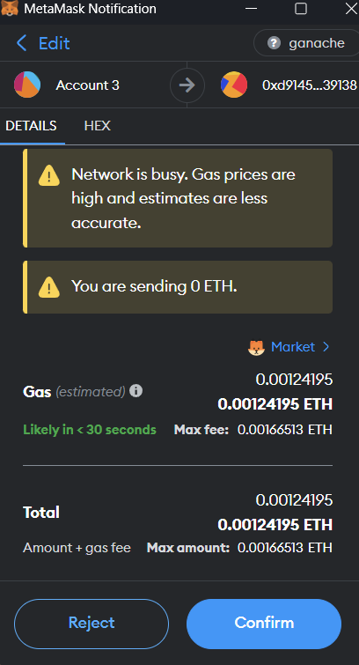
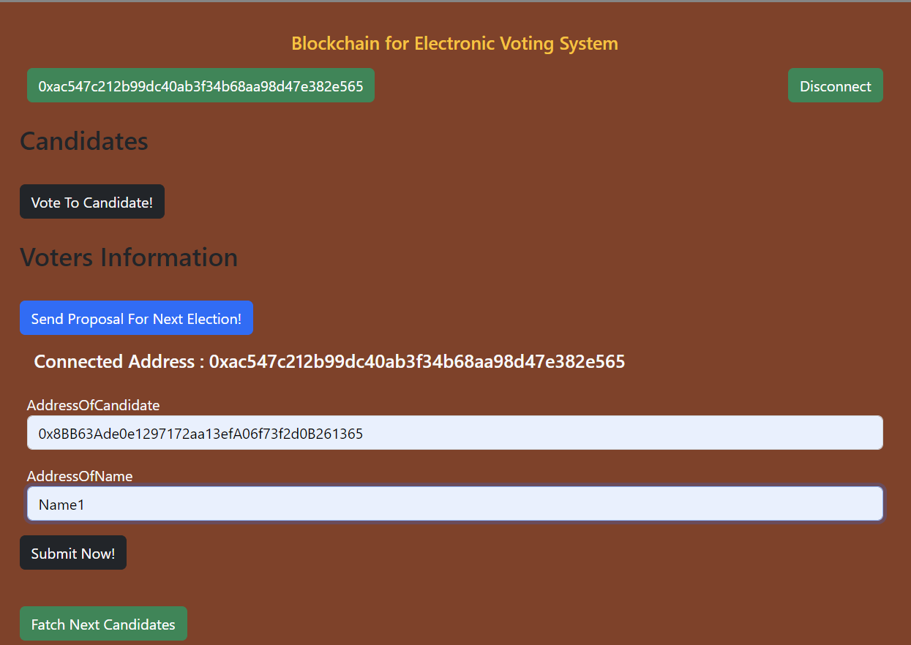

Slide 20
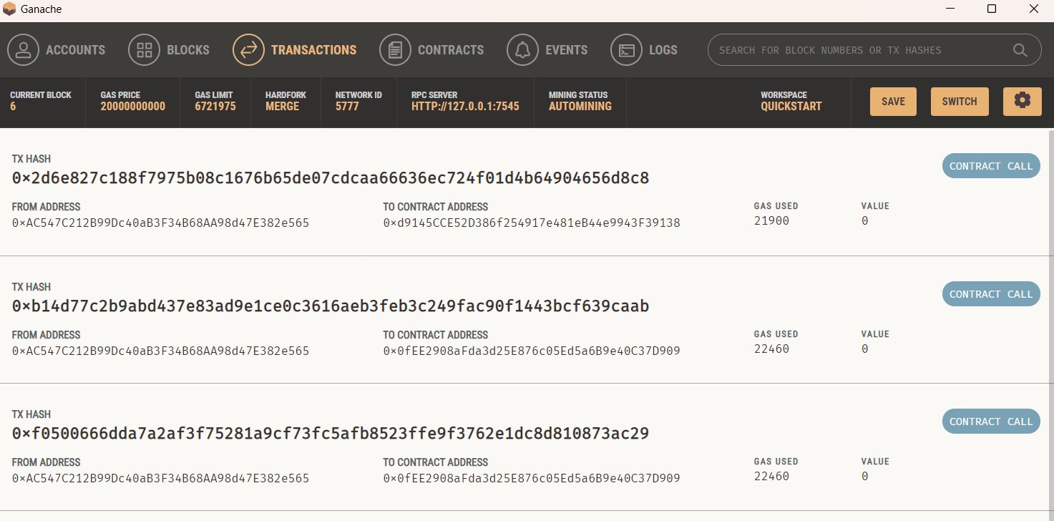

Slide 21
CHALLENGES AND LIMITATIONS of project
Voting is a fundamental democratic activity. Many experts believe that paper balloting is the only appropriate method to ensure everyone’s right to vote. But this method is prone to errors and abuse. Many nations utilize digital voting methods to solve the difficulties of paper balloting. A single flaw in digital voting may lead to massive vote-rigging. Election voting methods must be legal, accurate, safe, and convenient. However, issues with digital voting methods may restrict acceptance. Due to its end-to-end verification capabilities, blockchain technology was developed to address these problems. To guarantee We have used blockchain technology for anonymity, privacy, verifiability, mobility, integrity, security, and fairness in voting.

Slide 22
conclusion
To Overcome all the Shortcomings in the Present Voting System, we came up with the Modern Technology of Blockchain i.e. E-Voting System using Blockchain. By using this modern technology, following things can be Achieved:-
Cheap Voting System, Accurate Voting System, Fast Voting System. Every Citizen desires to have a Transparent and Direct Form of Democracy which is clear cut obtained from this E- Voting System using Blockchain.
Faith of People on the Voting System is Increased therefore, many People Come Forward for Voting, thereby Increasing the Percentage of the People Voted. The Pen and the Paper Election is Eradicated thereby creating Accuracy in the Voting System. Everybody Prefers Time ,and Cost Efficient Systems so this E-Voting System using Blockchain is apt for Transparent Democracy.
Ethereum Private Blockchain allows hundreds and hundreds of Transactions in a Second. Utilisation of the Smart Contracts lower the Load on the Blockchain. For Countries with Greater Population, some additional Technology should be added in this E-Voting System using Blockchain to avoid Errors. The main reason behind this system is to present an idea of implementation of blockchain in the voting system.

Slide 23
THANK YOU

